Slide 1
LegFree – Flow diagram
23.09.2022. by Hyun Suk, Lee
26.09.2022 – team meeting

Slide 2
Customer
Login
Register
Rental history
(optional)
LegFree
Login
Success
Register
Success
Reporting
Bike
N
N
Y
Y
Check the Bike’s location and status
The latest payment is normal?
Report bike
he rented
Rent
Map
Select a Bike
Y
N
Choose reason
Broken/Low battery
Popup
Your payment has an error
Rent a Bike
Current Status
Bike is holding
N
Is this Payment normal?
Y
Payment
Ride a Bike
Remarks
Return
Go Back to the station
Page
Action

Slide 3
Operator
Login
LegFree
Are you
Operator?
N
Y
Choose Report Reason
Broken / Low battery
Menu
Operation
Choose Broken
- Show List
Fix broken bike
Release hold
Choose Low Battery
- Show List
Charge bike
Release hold
Current bike
Map
Select bike want to move
Select the location to move
Change Location
Move OK

Slide 4
Manager
Login
LegFree
Are you
manager?
N
Y
Menu
Analysis 1
Delete ID
Analysis 2
Modify details
Analysis 3
Send notification to operator
(optional)
Add operator/MNG ID
List of all account
Manage account(ID)

Slide 5
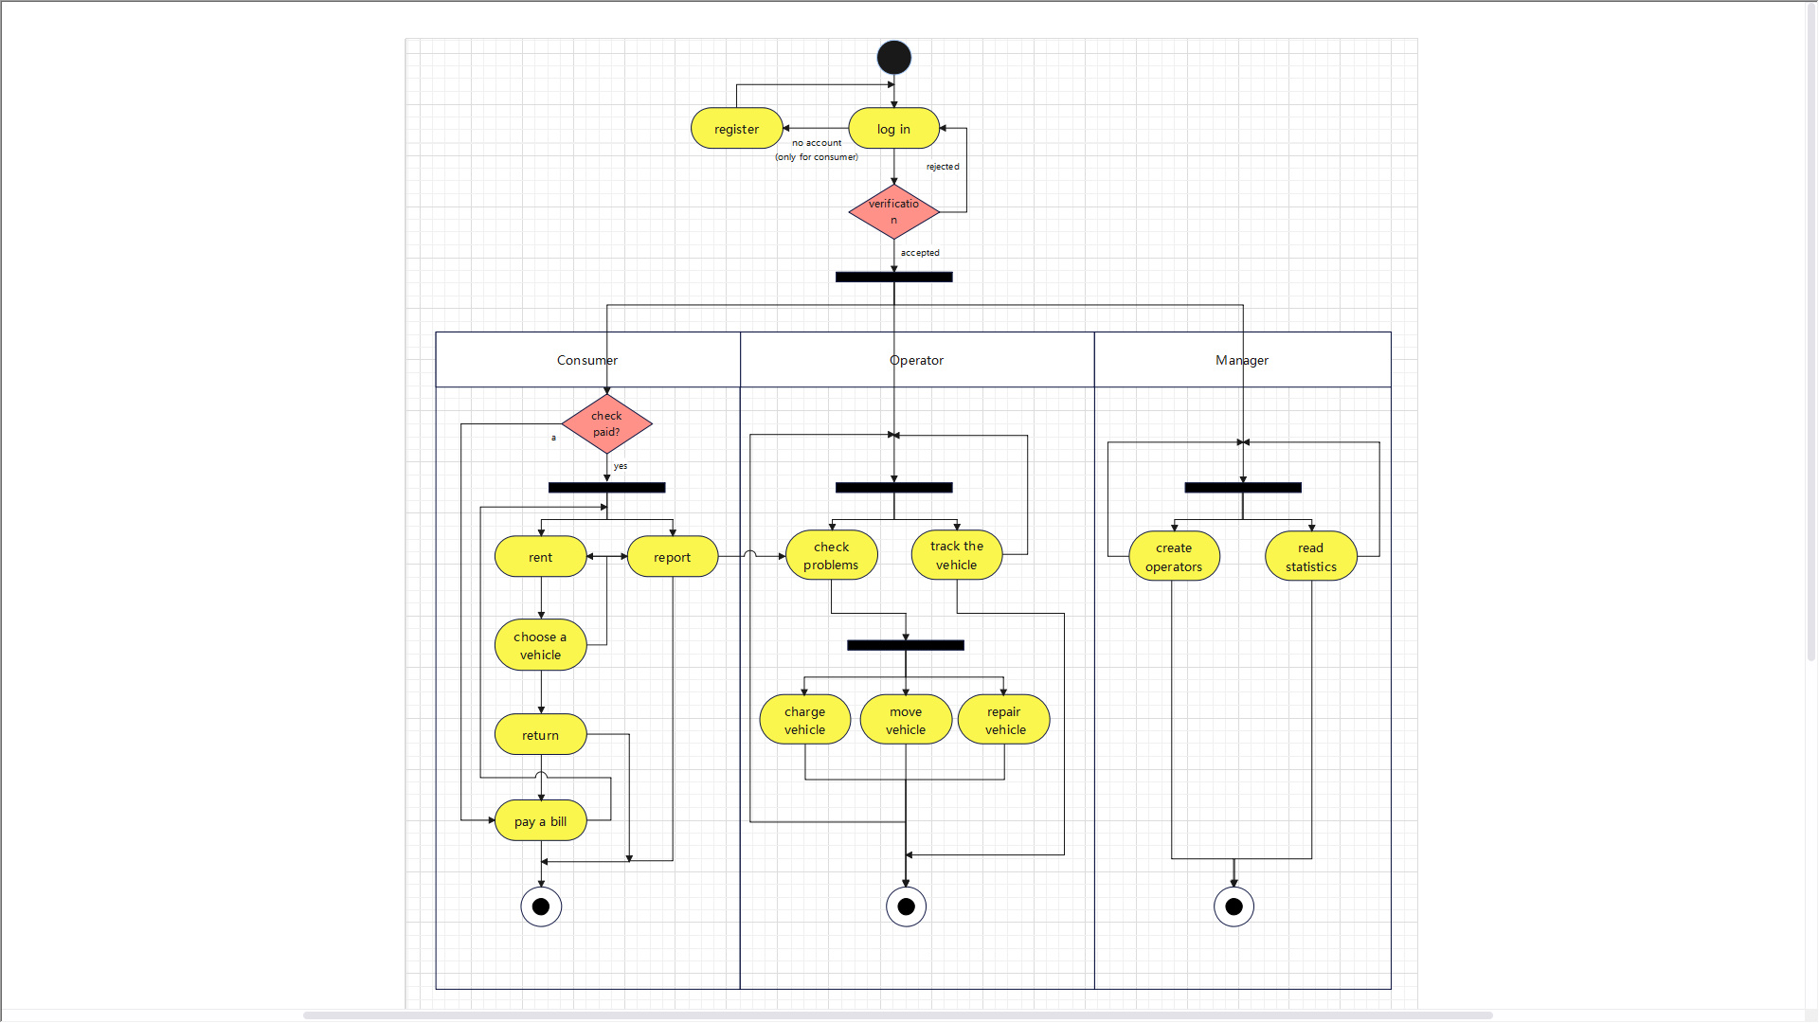

Slide 6
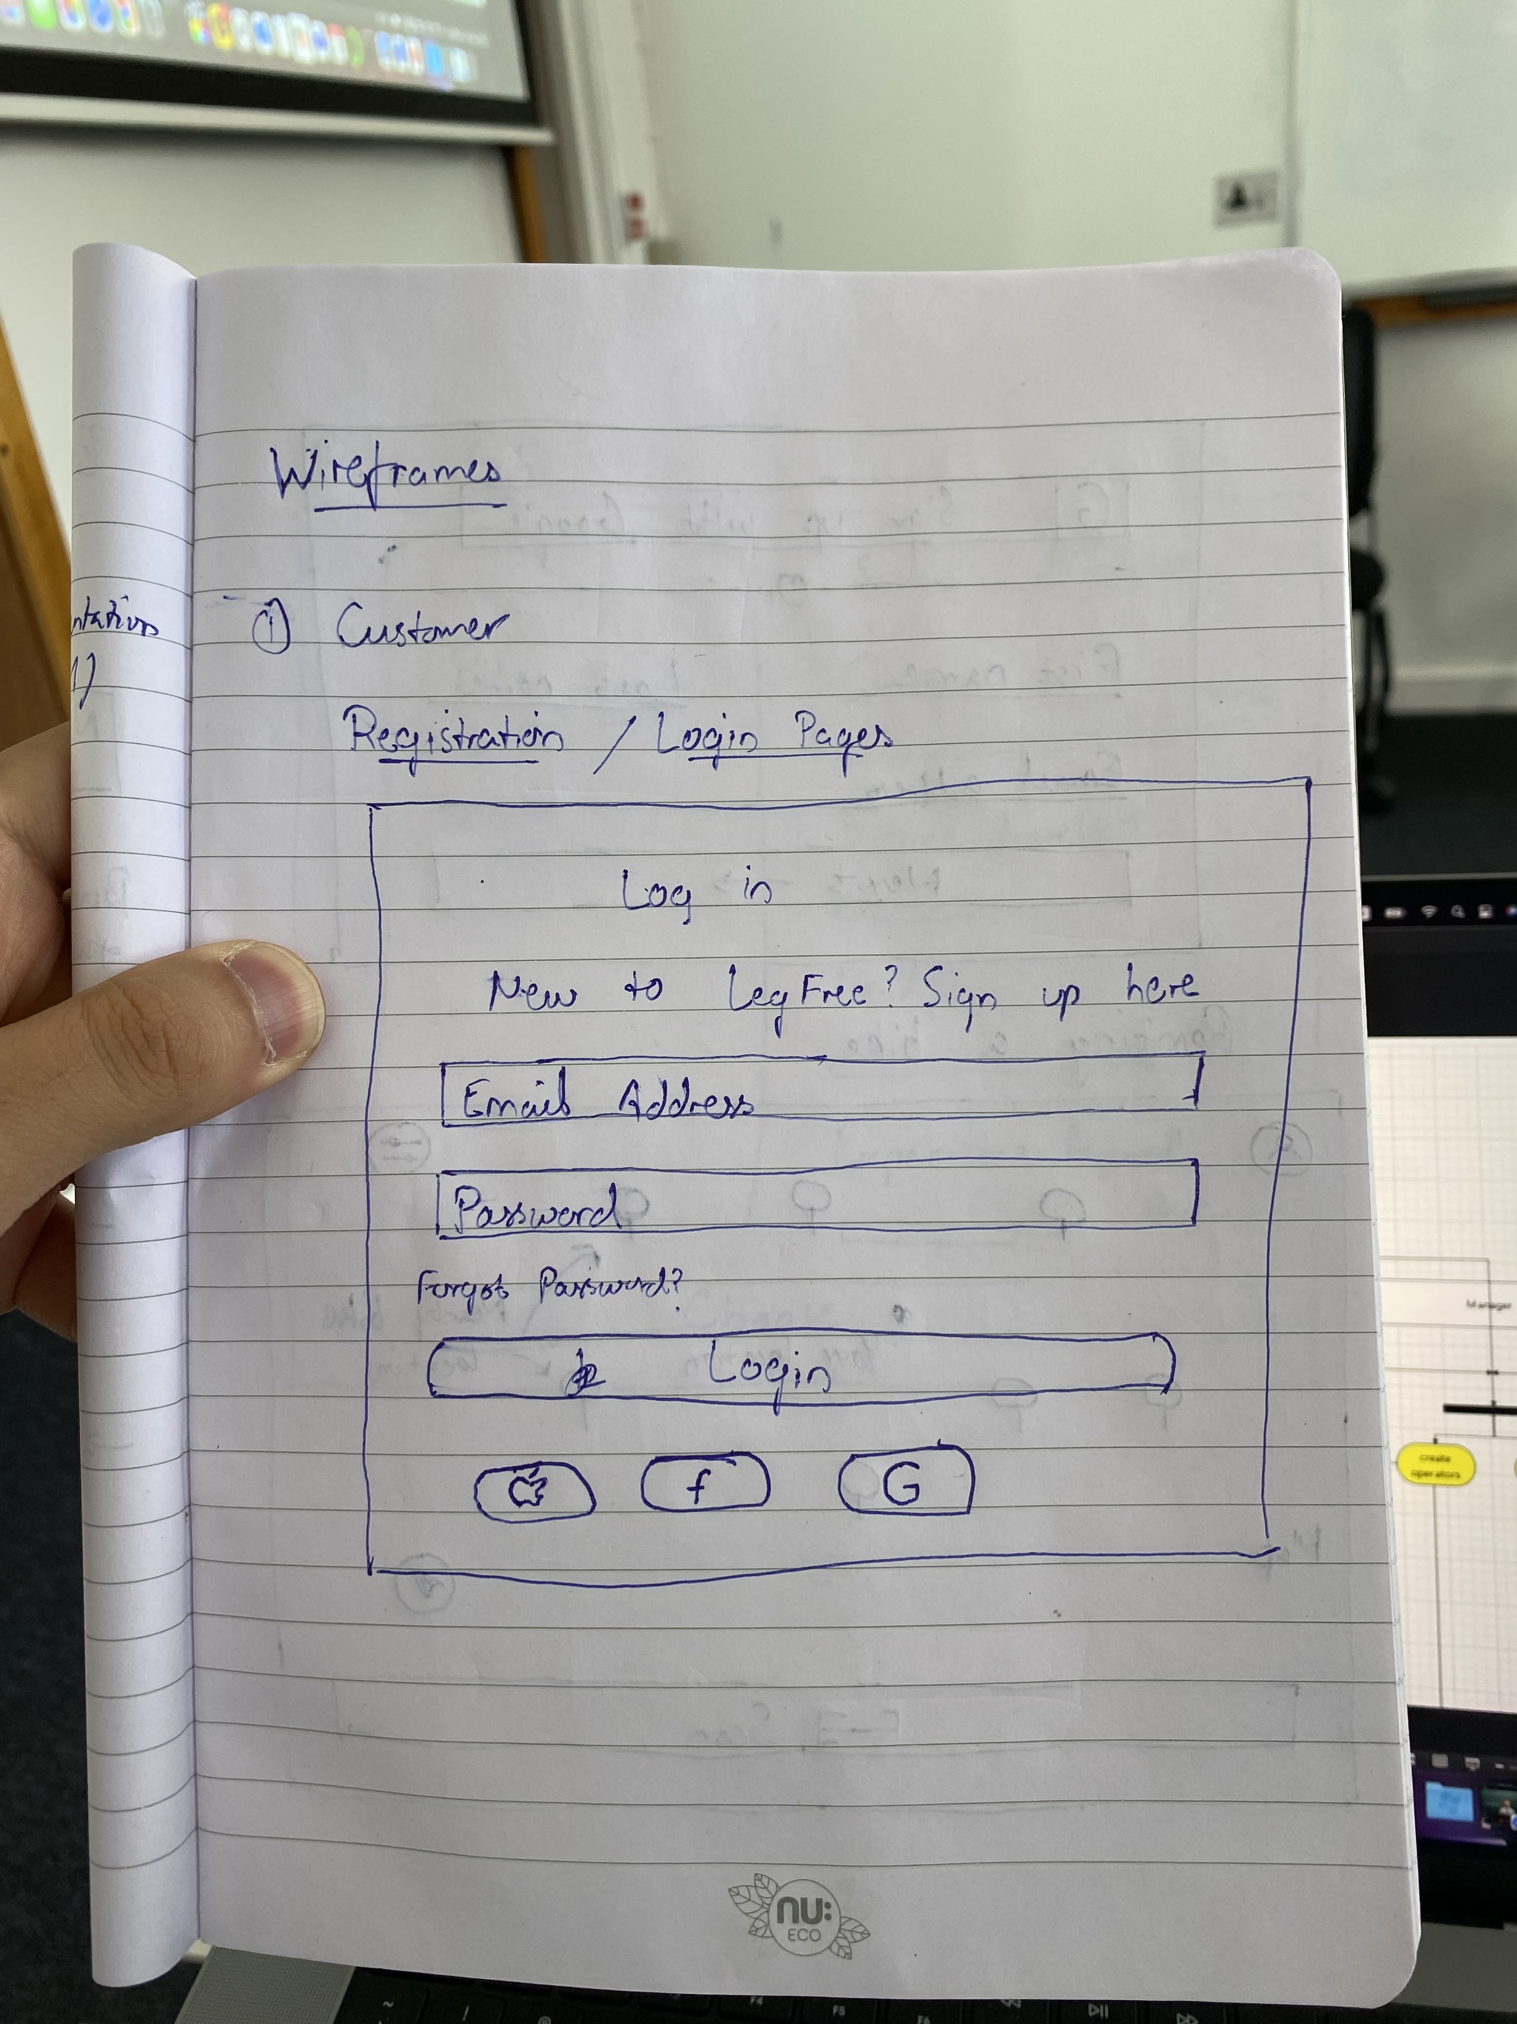
optional

Slide 7
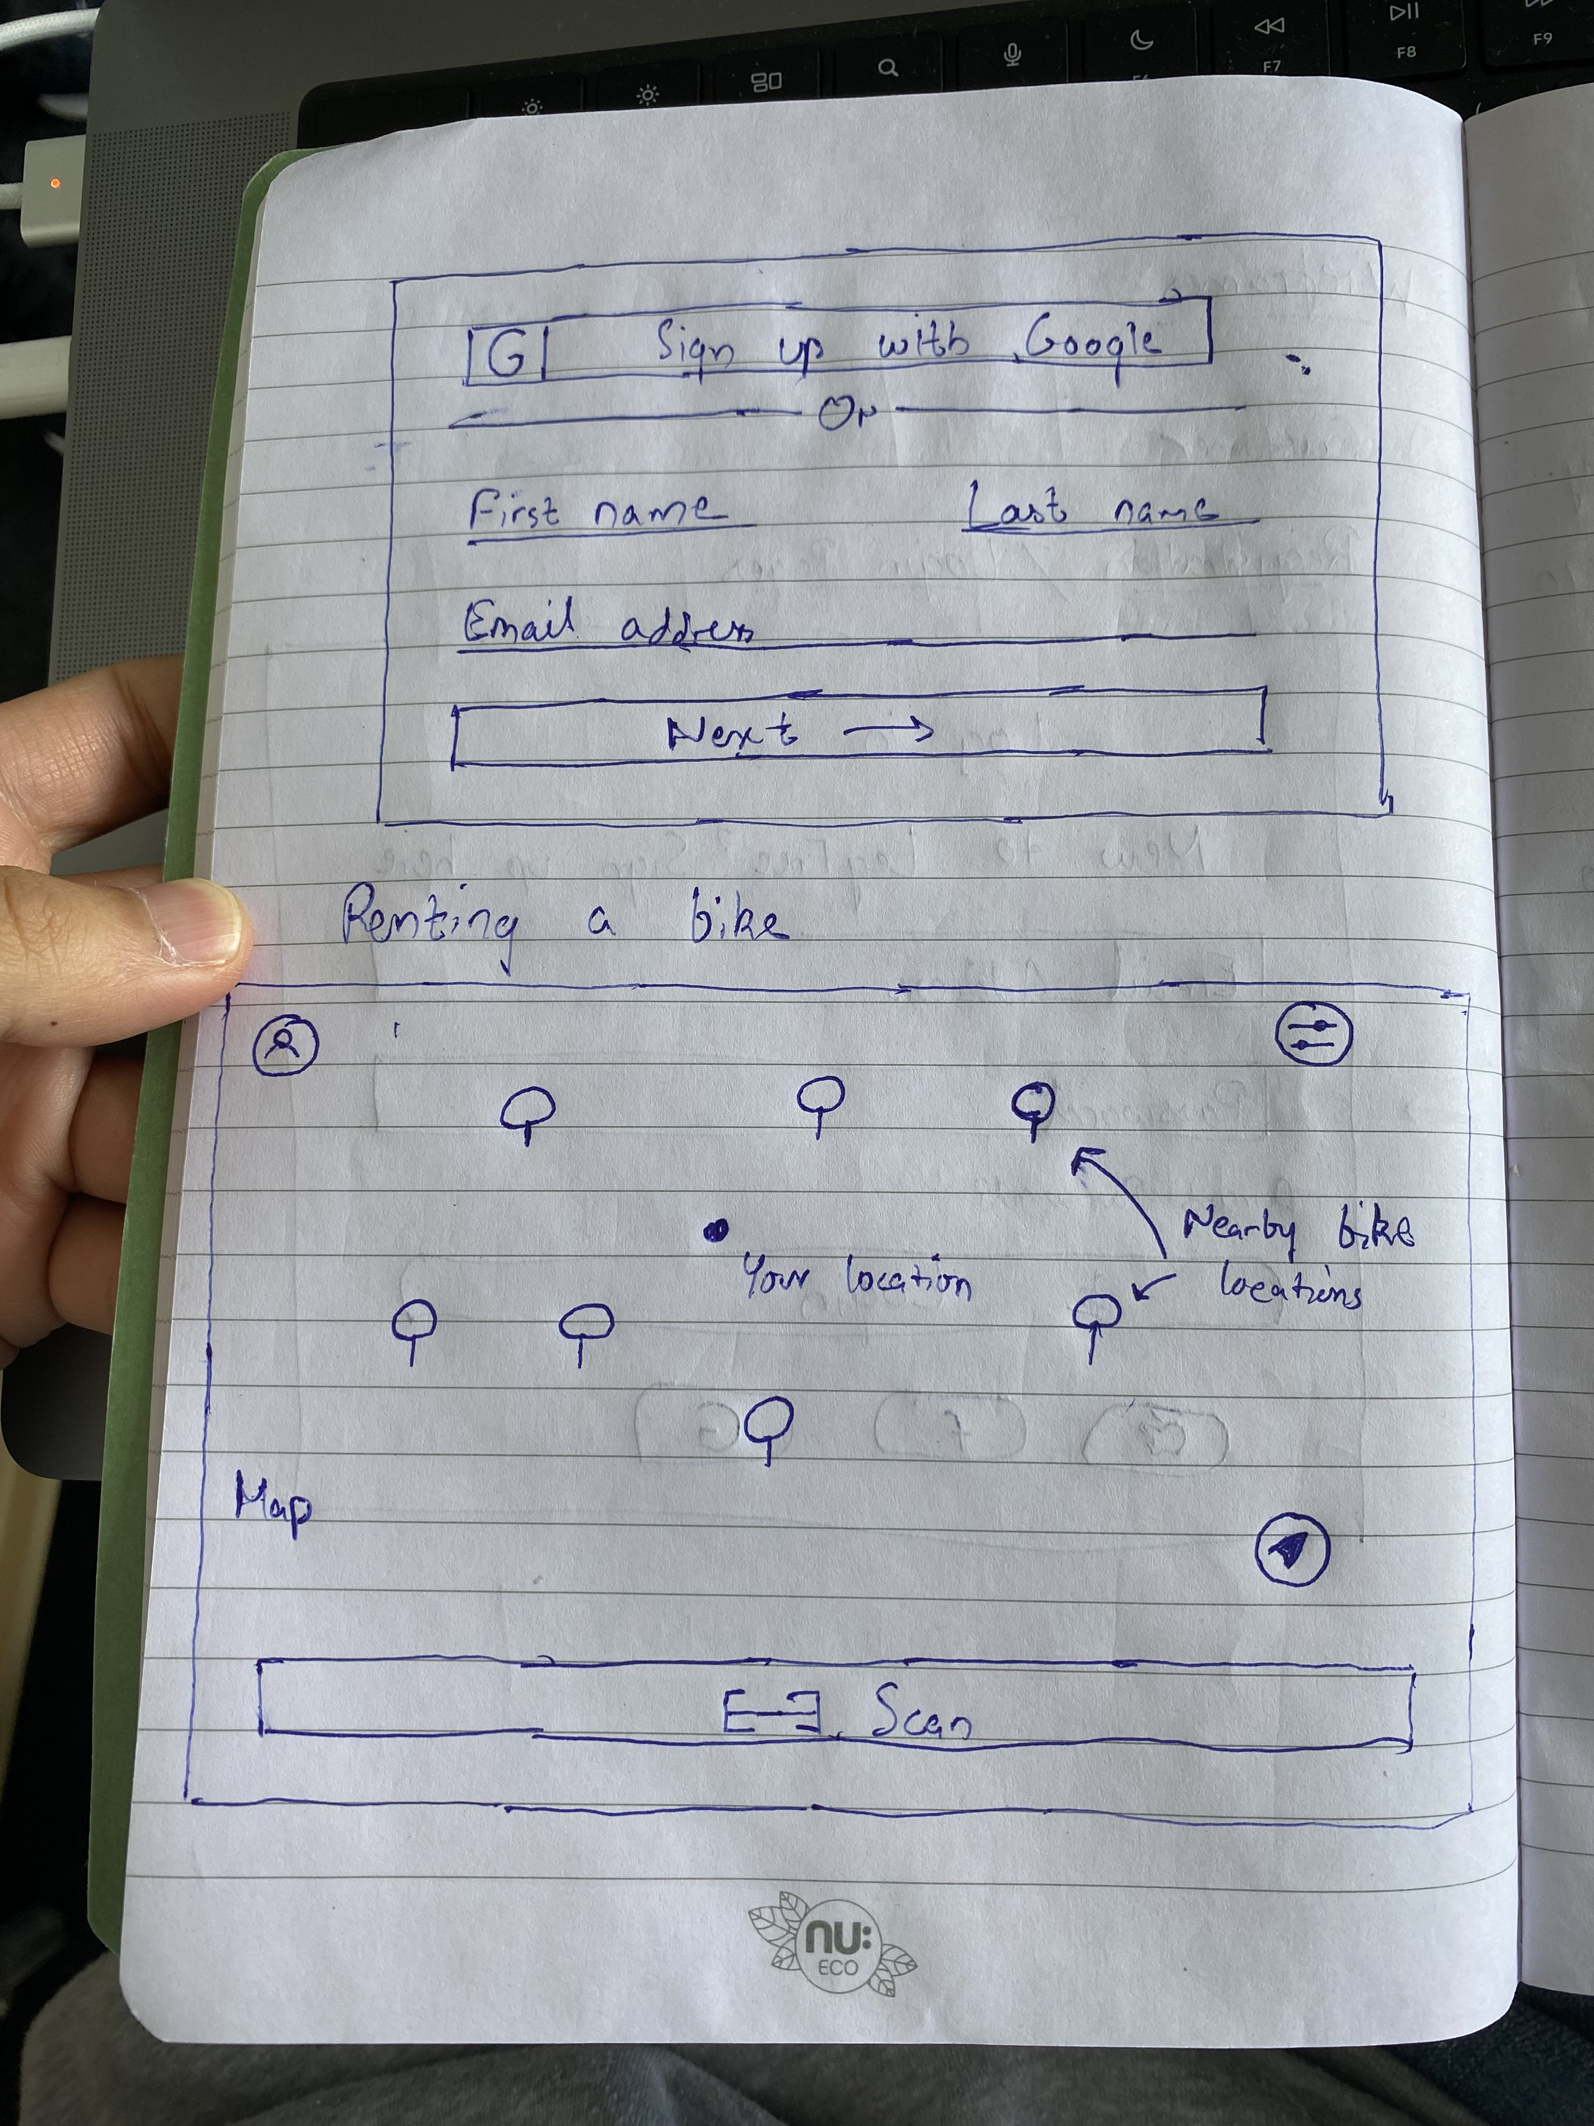
Register -
Name
Email
Password
Gender
Address
Contact no
Birthdate
Previous rent history
Bike list at station
location | Vehicle no
 | no1
 | no2
User details
Optional
location | Vehicle no | Status | Type
 | no1
 | no2
Report button
Current location
Optional->we need to input Bike code

Slide 8
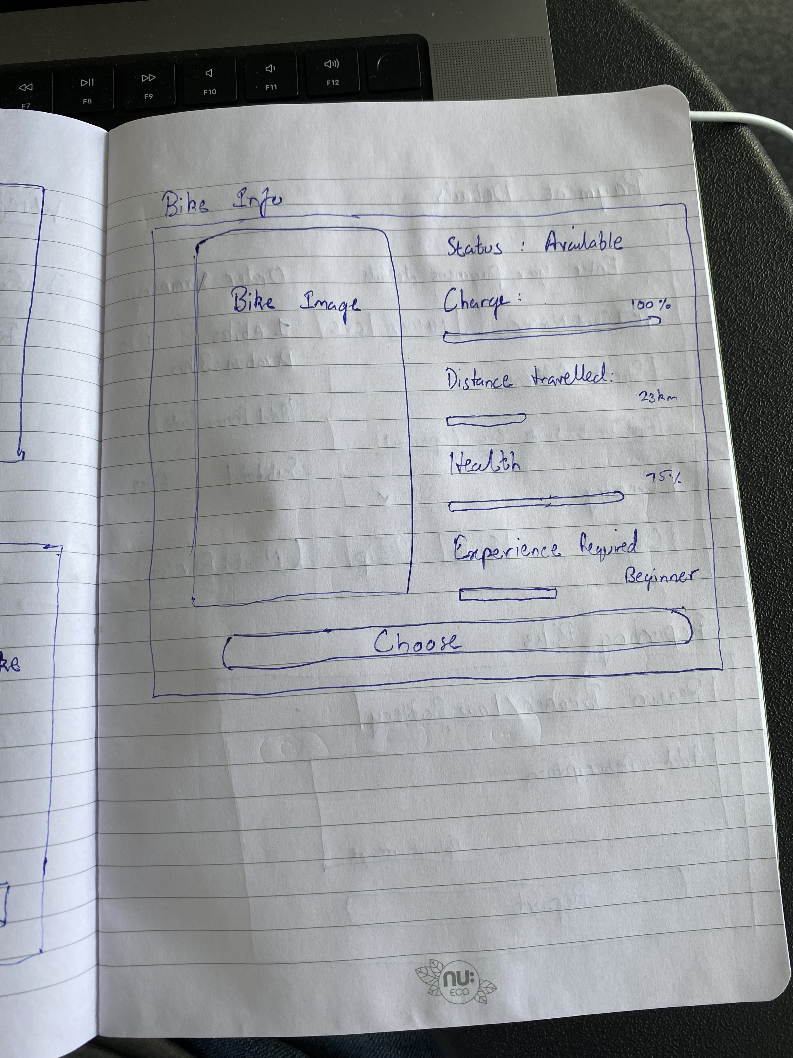
optional
Bike type

Slide 9
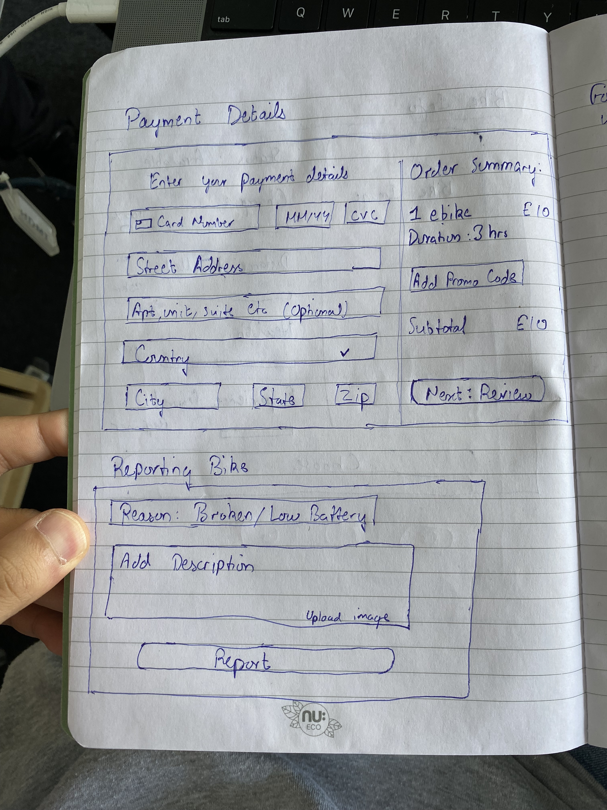
optional

Slide 10
Release bike holding(charge and repair()
List of bike holding
list
Sort by location/ cause
Info of bike
location | Vehicle no | cause | Report date
 | no1
 | no2
Put the description
(optional)
Release button

Slide 11
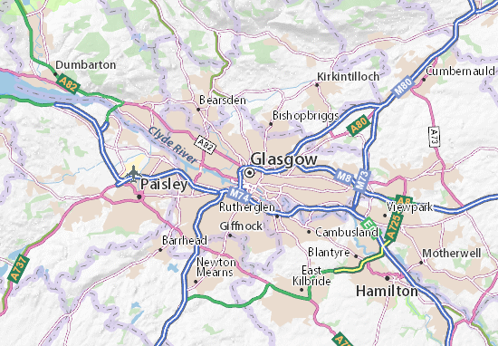
Change location
Bike list at station
location | Vehicle no | Status | Type
 | no1 | broken
 | no2 | LB
 | no3 | available | beginner
 | no4 | available | level 3
Chage location
To where : -------

Slide 12
